Slide 1

18ECE340T- MACHINE PERCEPTION WITH COGNITION
UNIT-4
Session-1
Finding Object by Template Matching

Slide 2
Cross Correlation (CC)
Template Matching achieved by cross correlation.
Cross correlation is a powerful tool to:
Find certain image content in an image
Determine its location in the image
Key assumption: Images differ only by
Translation
Brightness
Contrast
9

Slide 3
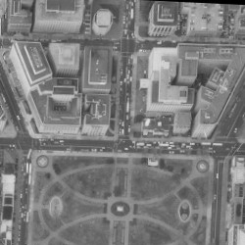
Template Matching
Find the location of a small template image within a (larger) image
Usually: size of template << size of image
?
template
image
10

Slide 4
Template Matching
Find the location of a small template image within a (larger) image
Usually: size of template << size of image
(0,0)
j
?
u
x
template and a point P_{m}
v
x
q
p
i
image
11

Slide 5
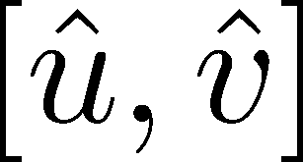
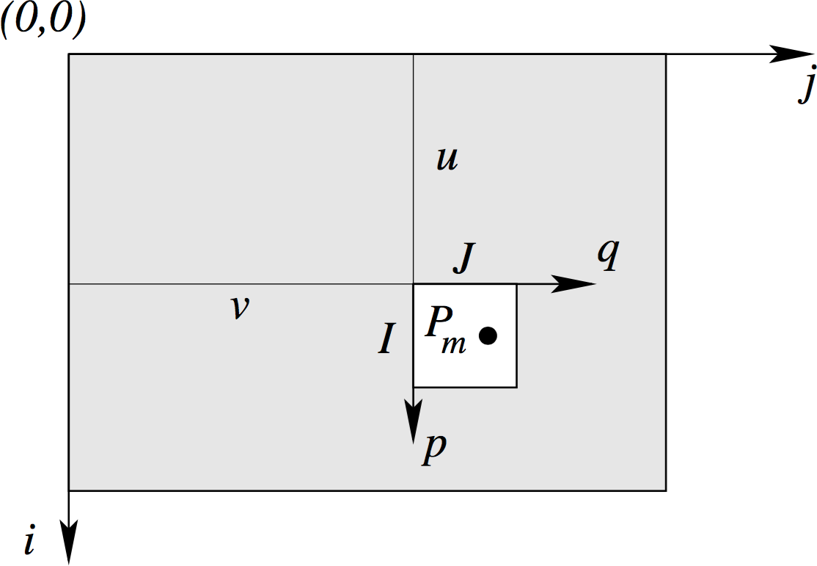
Principle
Given image g₁(i, j) and template g₂(p, q)
Find offset between g₁ and g₂
Image courtesy: Förstner
12

Slide 6
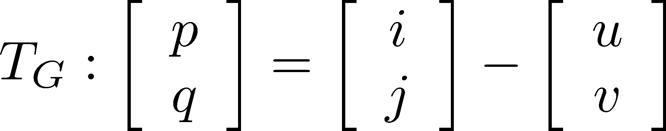




Assumptions
Geometric transformation
translation only
Two unknowns
Radiometric transformation _{brightness}
contrast
Intensities of each pixel in g₂ are linearly dependent of those of g₁
Two additional unknowns

Slide 7
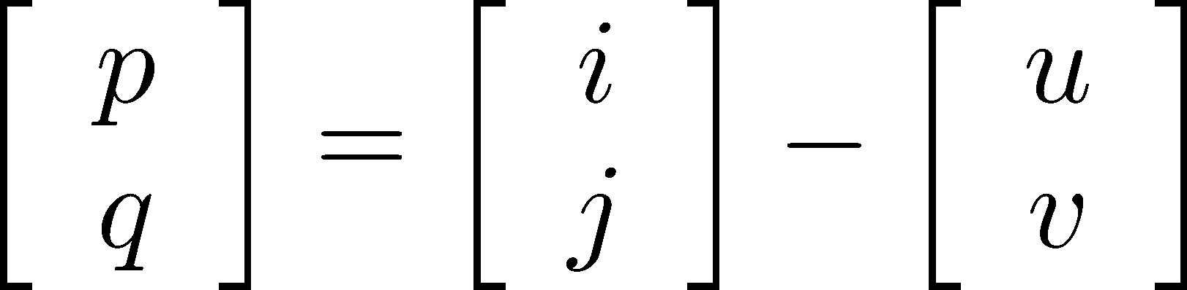

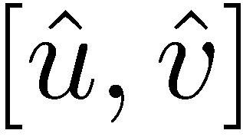
Problem Definition
Task: Find the offset that maximizes the similarities of the corresponding intensity values
How to quantify “similarity”?

Slide 8
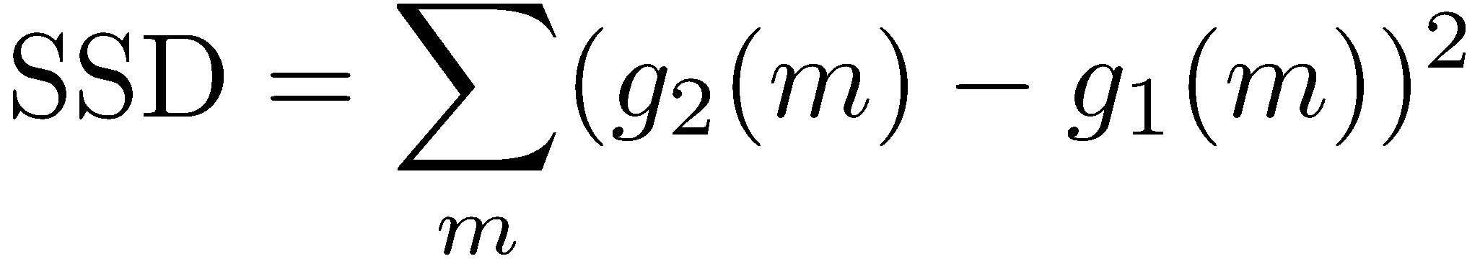
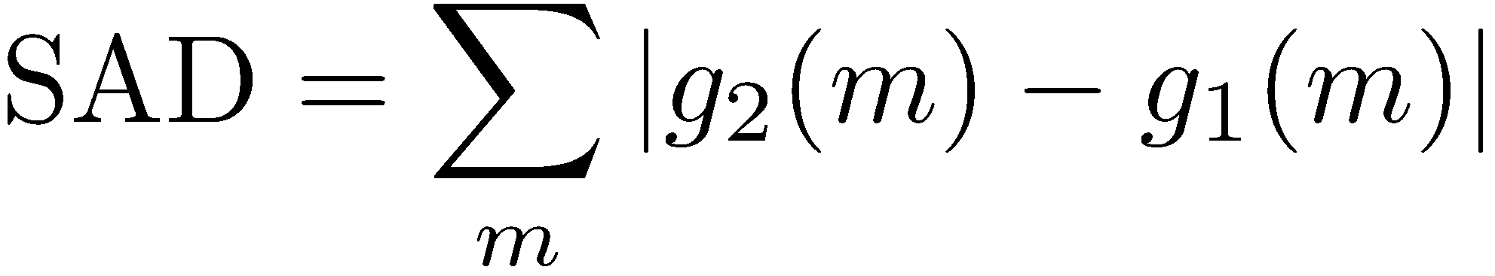

Typical Measures of Similarity
Sum of squared differences (SSD)
Sum of absolute differences (SAD)
Maximum of differences
No invariance against changes in brightness and contrast!

Slide 9
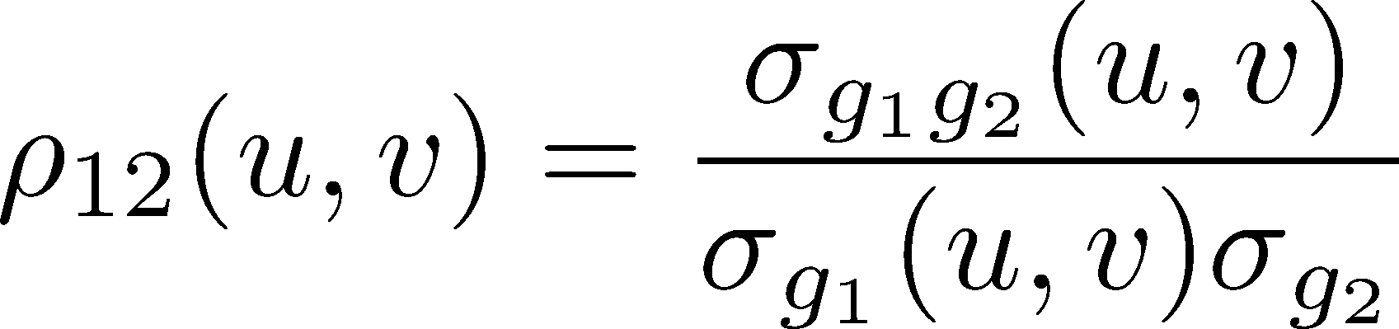
Cross Correlation Function
Best estimate of the offset is given by maximizing the cross correlation coefficient over all possible locations

Slide 10



Normalized Cross Correlation
Product of the variations of intensities from mean in template and image
Standard deviation of intensity values of
the image in the area overlayed by template
Standard deviation of intensity values of the template

Slide 11

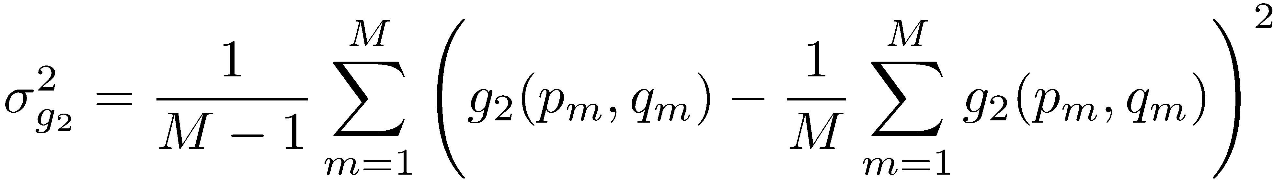

Normalized Cross Correlation
Standard deviation of intensity values of template g₂
Number of pixels in g₂
Sum over all
rows and columns
Mean of intensities in g₂
of the template g₂

Slide 12
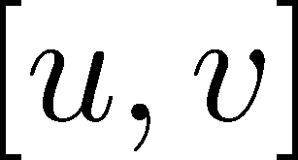
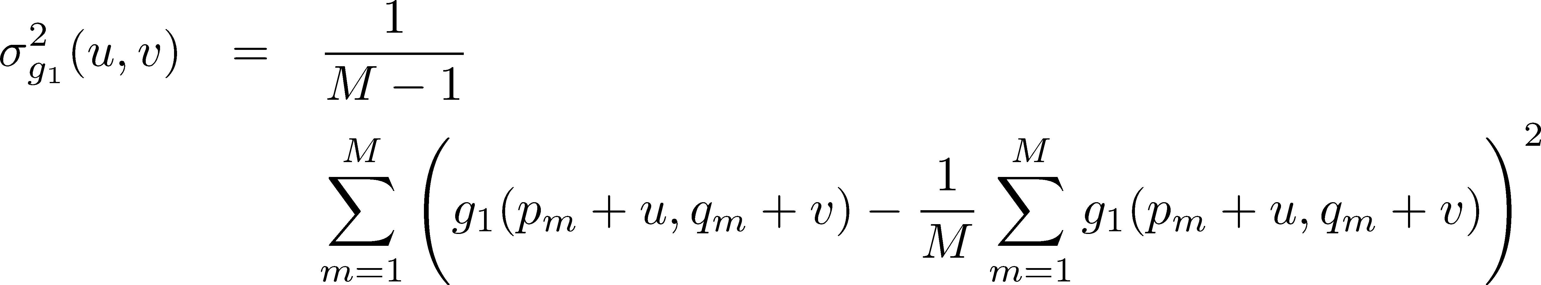

Normalized Cross Correlation
Standard deviation of intensity values of g₁ in the area overlapping with template g₂ given offset
Number of pixels in g₂ !!
Sum over all
rows and columns in overlap area with template g₂
Mean of intensity values in overlap area
19

Slide 13

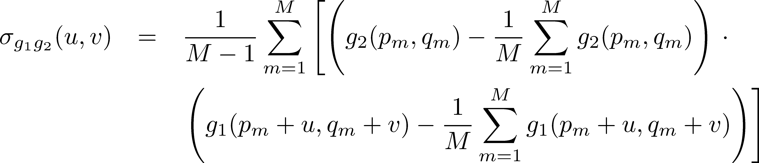
Normalized Cross Correlation
Covariance between intensity values of g₁ and in the overlap area with template g₂ given offset
20

Slide 14
Search Strategies
How to search the best position?
?
Image courtesy: Förstner
21

Slide 15
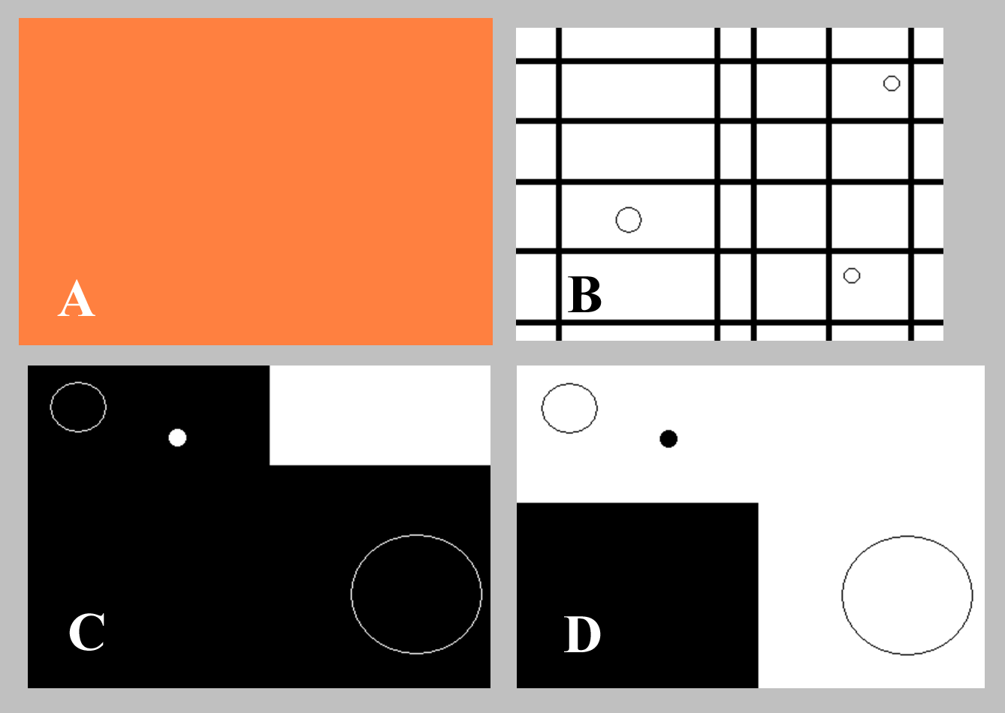
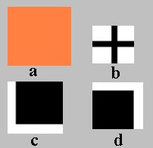
Example
Cross correlation of
a and A: ?
b and B: ?
c and C: ?
d and D: ?
25

Slide 16
Example
Cross correlation of
a and A: no match, ρ = 1 everywhere
b and B: ?
▪ c and C: ?
▪ d and D: ?

Slide 17
Example
Cross correlation of
a and A: no match, ρ = 1 everywhere
b and B: several matches, ρ = 1 at every cross
▪ c and C: ?
▪ d and D: ?

Slide 18
Example
Cross correlation of
a and A: no match, ρ = 1 everywhere
b and B: several matches, ρ = 1 at every cross
▪ c and C: no match
▪ d and D: ?

Slide 19
Example
Cross correlation of
a and A: no match, ρ = 1 everywhere
b and B: several matches, ρ = 1 at every cross
c and C: no match
d and D: exactly one match

Slide 20
Basic Cross Correlation
Searches for a template image in another image
CC is fast and easy to compute
CC allows for variations in translation, brightness, contrast
Changes in brightness and contrast though cross correlation function
Search space defined by the translation parameters

